Slide 1


Gun Violence in
America
1982 - 2023

Slide 2
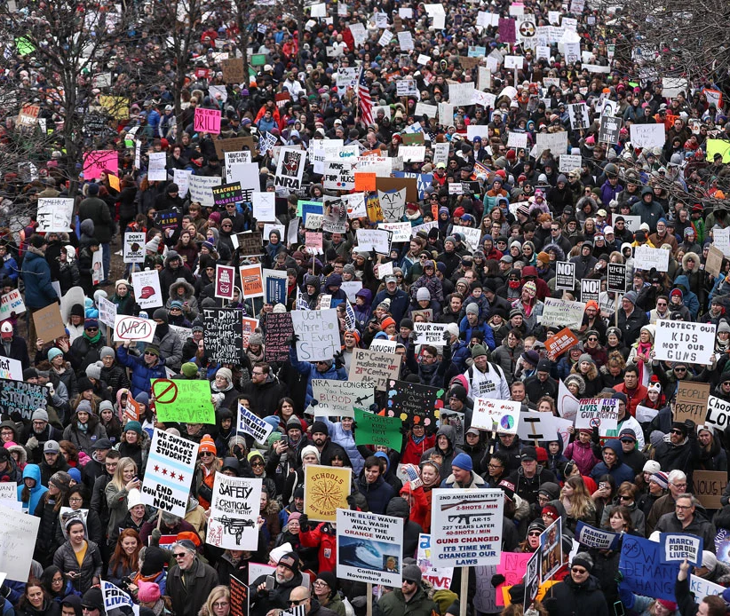
Our Team
Bethelhem Arefayne
Maksym Andreiko
Umeadi Dungor

Slide 3

The purpose of this project is to analyze major gun shooting incidents that have occurred in the United States over the last four decades.
Examined data on:
The number of incidents.
Location where they occurred.
Breakdown of the causalities.

Slide 4




Discovery
Transformation (ETL)
Data source: Kaggle
File type: csv
Link: Gun Violence, USA
Loaded csv file, changed data types, filled in missing data and exported dataframe to database.
Process of the project.
Analysis
Visualization
Conducted exploratory data analysis to gain insights into the underlying patterns and relationships in the data.
Created charts and maps to help demonstrate the findings of the data analysis.

Slide 5





TECHNOLOGIES USED
Displayed data analysis charts with Apexcharts and interactive map with Leaflet.
5 - Apexcharts, Leaflet
Used to design the user interface for the web application.
4 - JavaScript, HTML, CSS
Flask framework served as the backend API.
3 - Flask
Stored data in SQLite database.
2 - SQLite
Pandas library was used for ETL.
1 - Pandas/Python

Slide 6
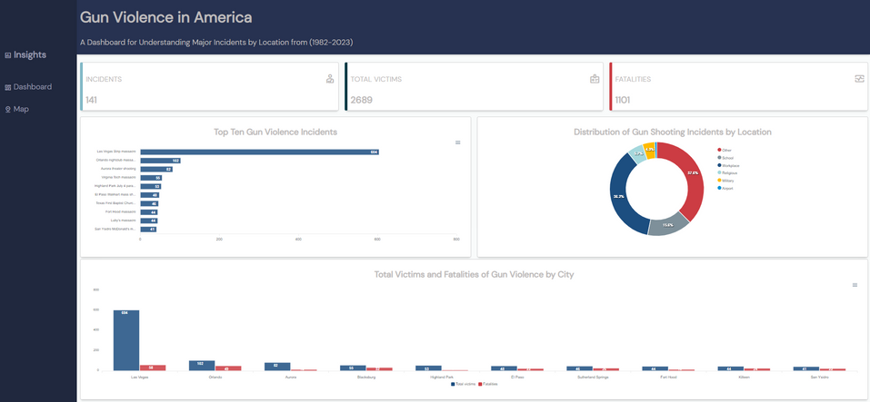
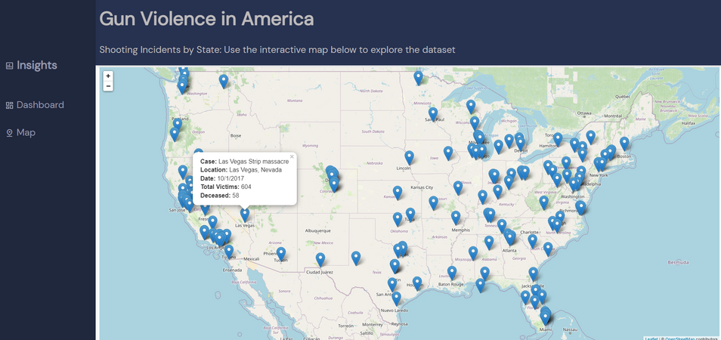
Overview of the web pages
Dashboard
Map
Displays KPIs and charts of data analysis results.
Displays the distribution of the incidents across the states.

Slide 7
Key chanllenges
Recomendations
Small data size caused limitations to analyze and present data.
Null values and quality of data limited the identification of significant trends.
Outlier record affected presentation of data.
Join additional datasets to gain more insights.
Add filters to dashboard and map to make visualizations more interactive.
Exclude outlier from certain charts.

Slide 8

Demo

